Slide 1

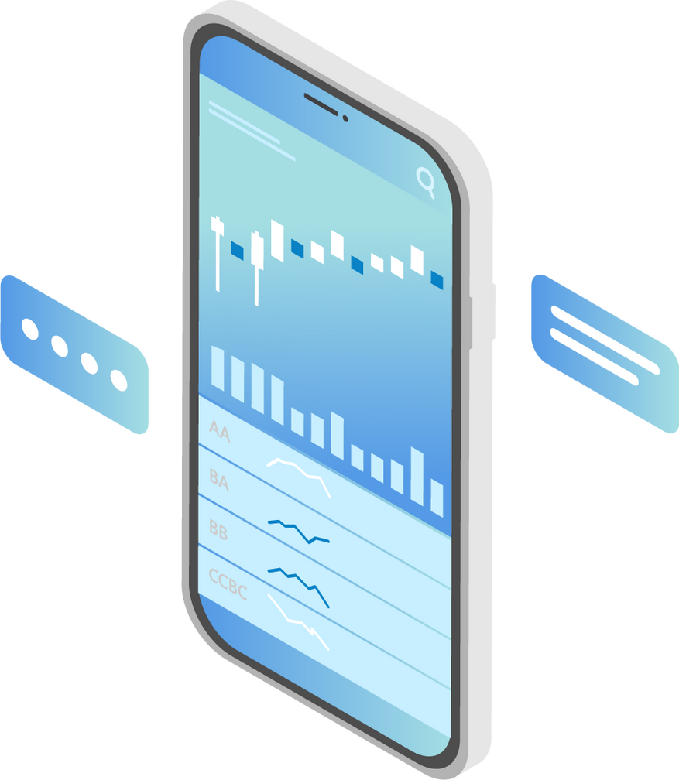
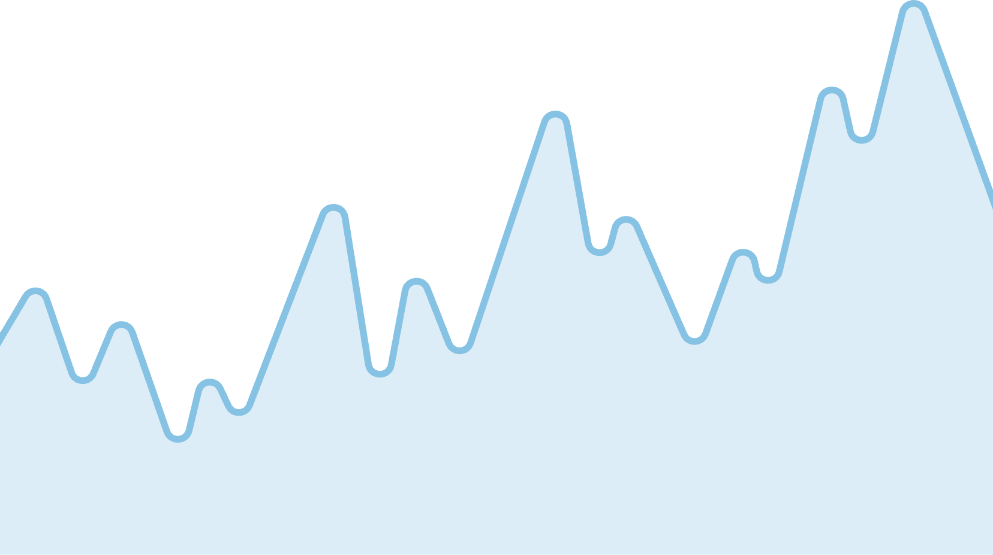
IE 5374 - Applied Generative AI
RebalanceAI: AI-Powered Investment Portfolio Analyzer
Group No: 4
Team Members:
Nishchay Linge Gowda
Shivakumar Hassan Lokesh
Supriya Singh

Slide 2
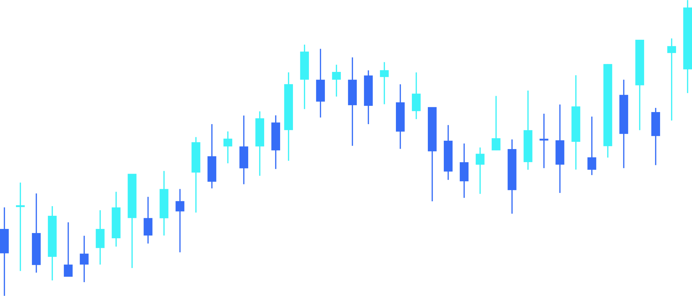

Problem Statement
❌ Relying only on news hype ignores real volatility
Why Traditional Portfolio Decisions Fail ?
❌ Relying only on past performance ignores current sentiment
❌ Manual research is slow, biased, and inconsistent
There is no objective system that blends financial stability + market psychology together.

Slide 3
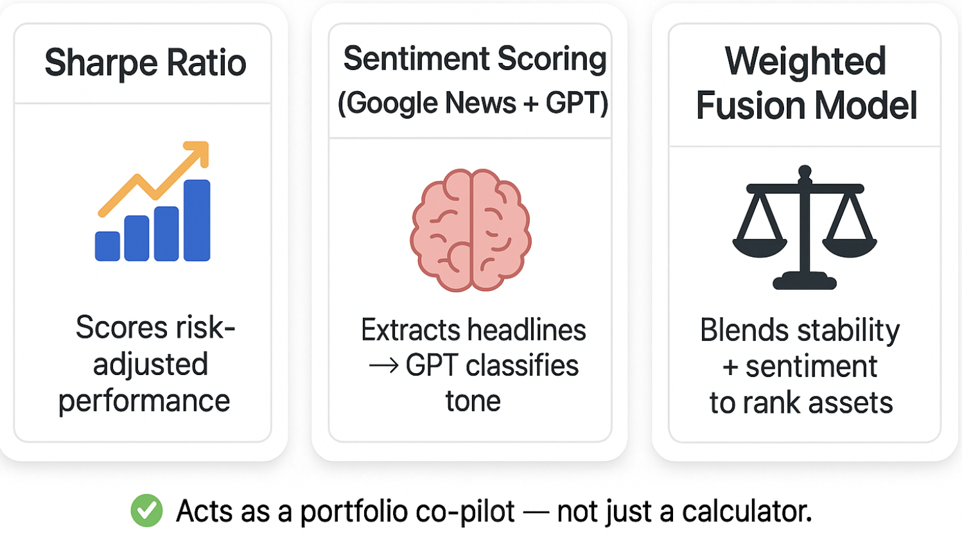

Introducing RebalanceAI
An AI Agent That Fuses Data Discipline with Market Emotion

Slide 4
System Architecture
S&P 500 Stock List
Historical Price Data
Google News Headlines
Compute Sharpe Ratio
GPT-Based Sentiment Scoring
Final Weighted Score = Sharpe × Sentiment
✅ Top-Ranked Portfolio Allocation

Slide 5

✔ Rewards consistent performers
✔ Penalizes unstable spikes
Scoring Logic
Sharpe Ratio (60% Weight)
(Sharpe + Sentiment Fusion)
✔ GPT analyzes recent news tone
✔ Captures hype or fear beyond numbers
Sentiment Score (40% Weight)

Slide 6
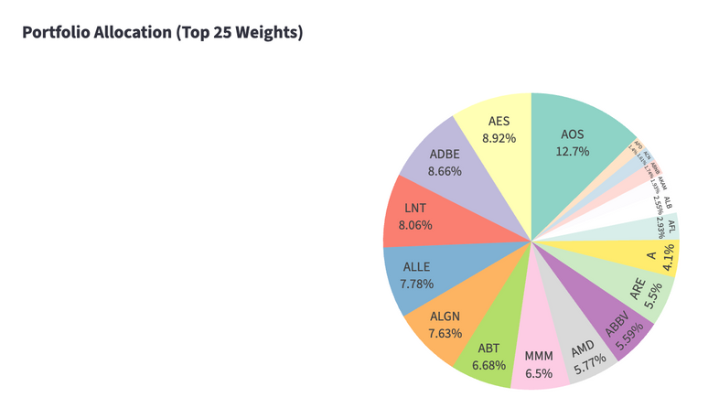
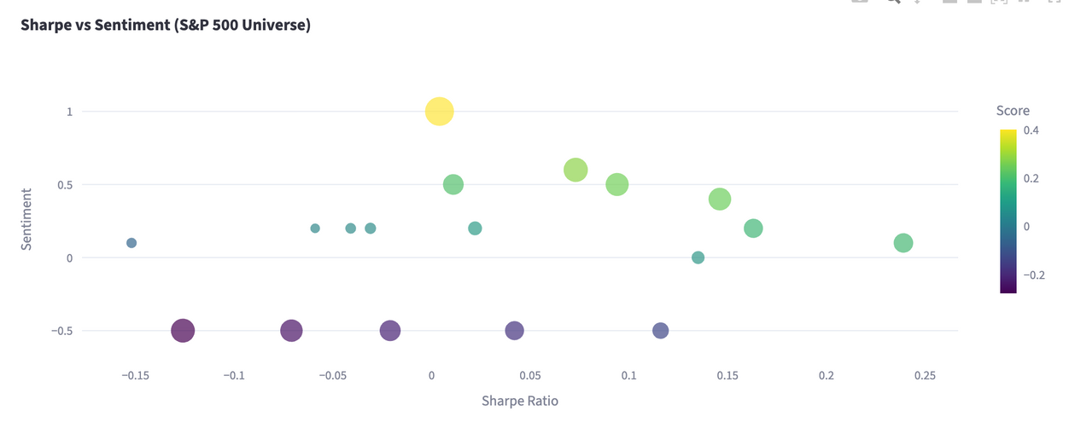
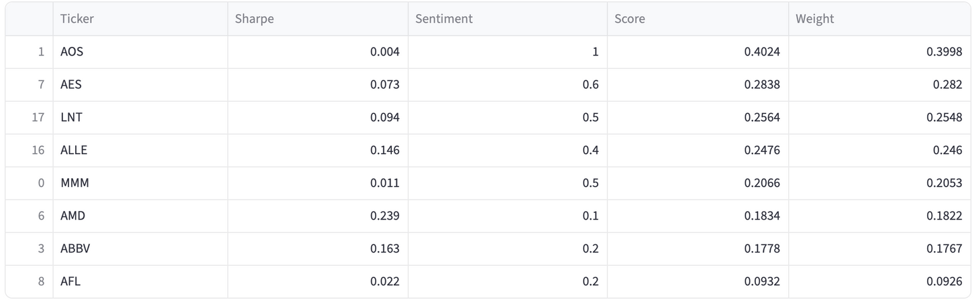
Portfolio Output
(Quantitative Results)
Diversification Pie Chart
Sharpe vs Sentiment Scatter Plot
Top Allocation Table

Slide 7
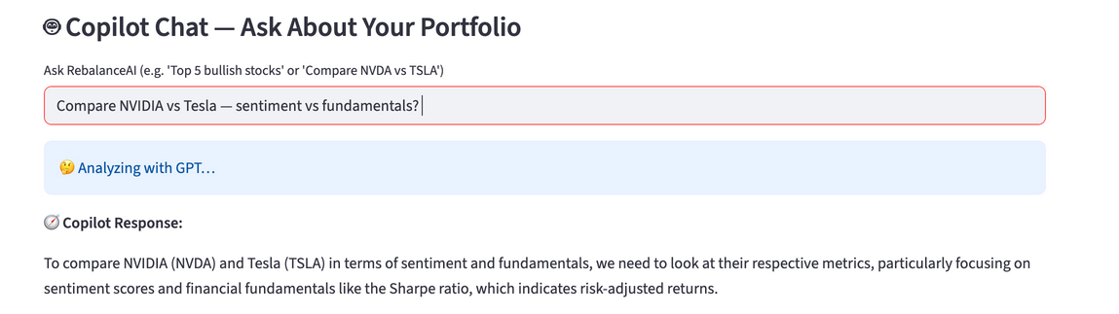
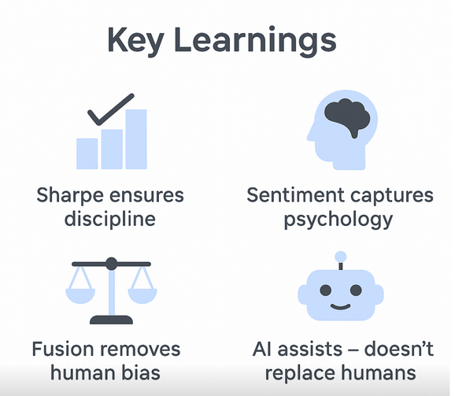

AI Interaction & Learnings
How Users Interact with RebalanceAI
Key Learnings
Which stocks have high hype but low stability?”
Compare NVIDIA vs Tesla — sentiment vs fundamentals?
Rebalance me toward a safer allocation
Sentiment alone → can overvalue hype & speculation
Sharpe alone → punishes fast-growing outliers ignores momentum
Fusion Model (Sharpe × Sentiment) → balances stability and opportunity

Slide 8

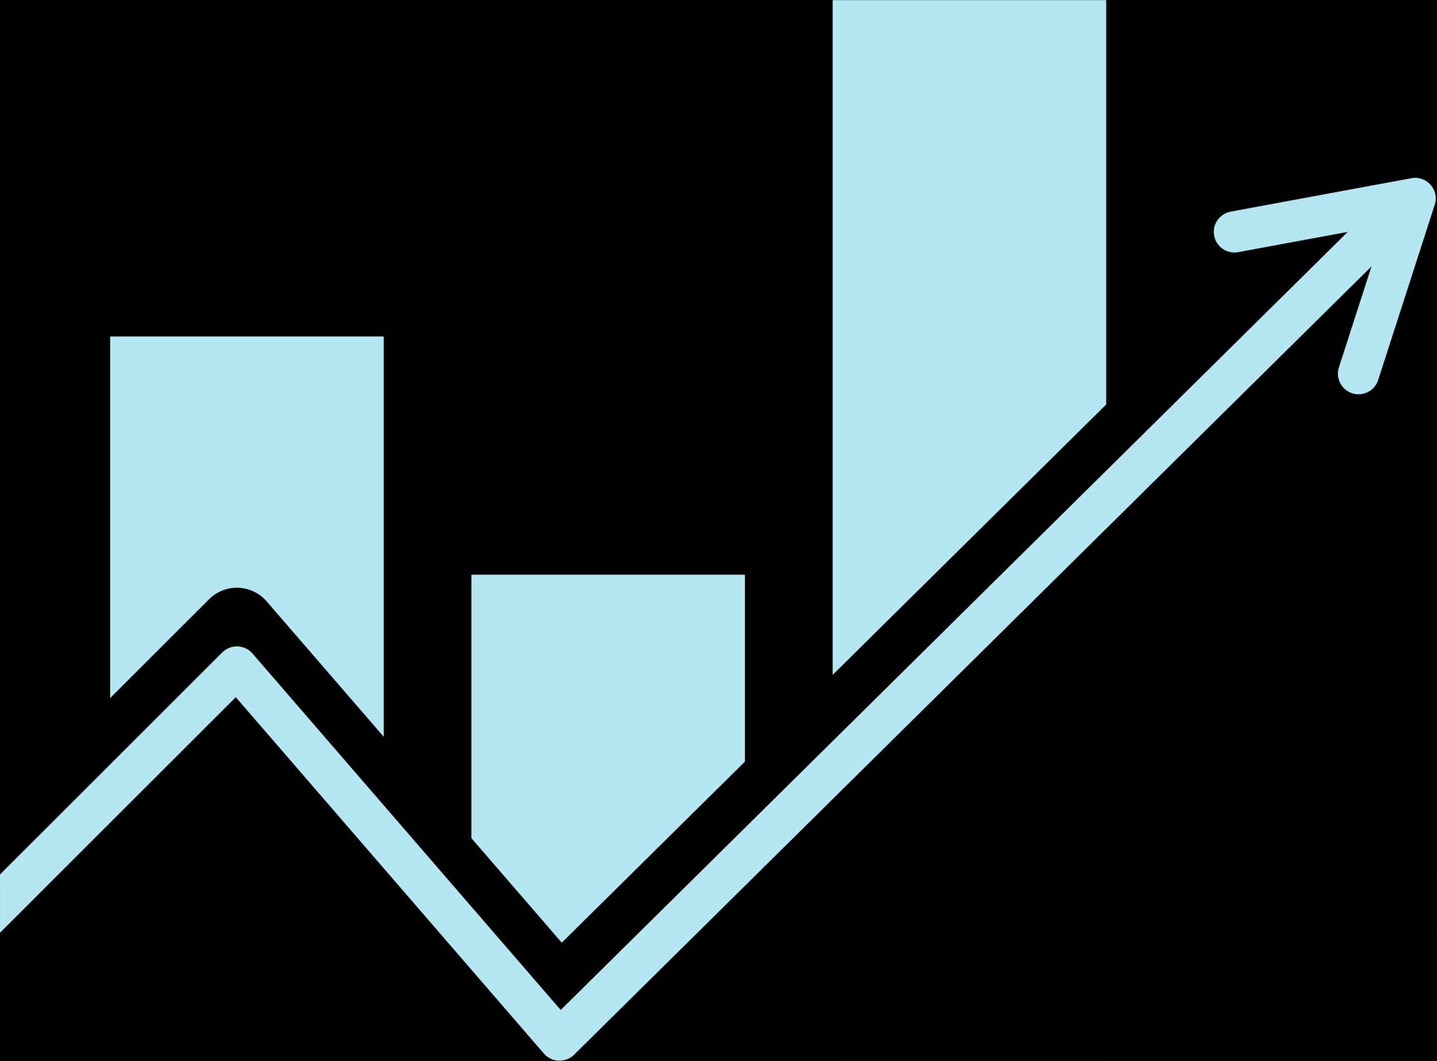
Conclusion & Next Steps
What RebalanceAI Proves
Next Steps
Numbers alone are not enough — Sharpe shows stability but misses momentum
Headlines alone are not trustworthy — sentiment can be hype-driven
AI fusion enables rational + emotional intelligence in investing
Expand sentiment scoring to compare GPT vs Claude vs Gemini for bias reduction
Introduce Sector-wise diversification caps
Enable “risk profile sliders” for user personalization

Slide 9

Thank
You!

